Slide 1
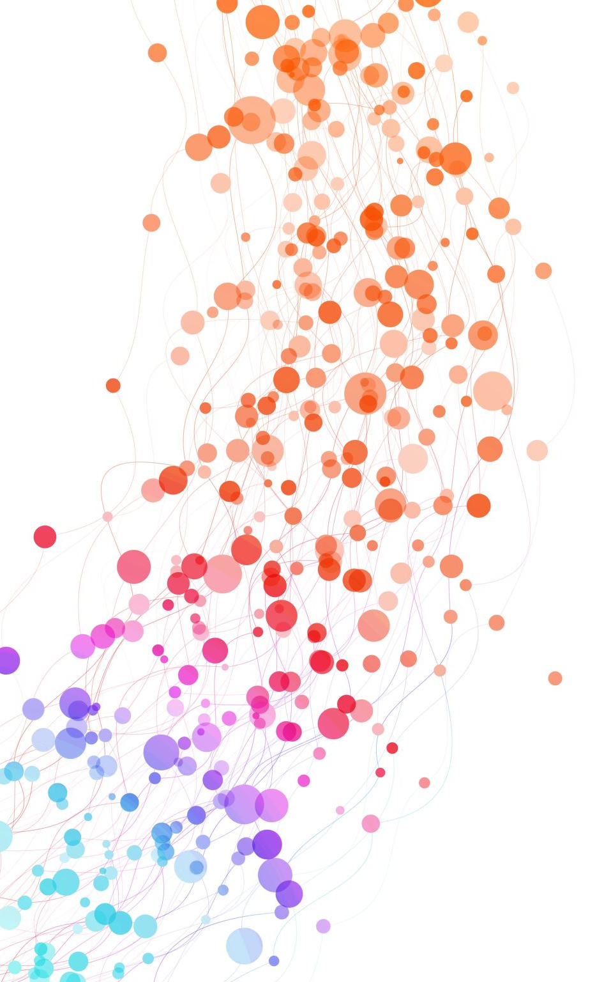
Wireless Sensor Network Data Analysis using Machine Learning
QSTEM Academy research
Elena Chagaeva
LaGuardia college
2024

Slide 2
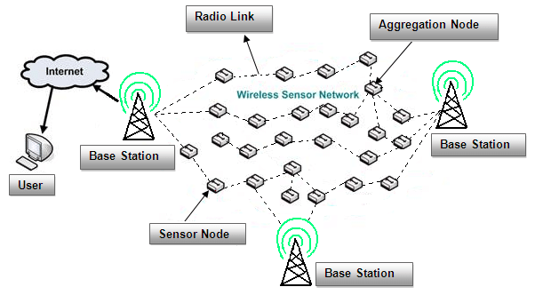
Understanding Wireless Sensor Networks (WSNs)
A WSN is a network of wireless sensors deployed in an ad-hoc manner without a fixed infrastructure.
These sensors monitor environmental conditions like temperature, humidity, and air quality.
Sensors communicate with a Base Station, which processes and relays data, often connected to the Internet.
Types of WSNs
Terrestrial WSNs
Underground WSNs
Underwater WSNs
Multimedia WSNs
Mobile WSNs

Slide 3
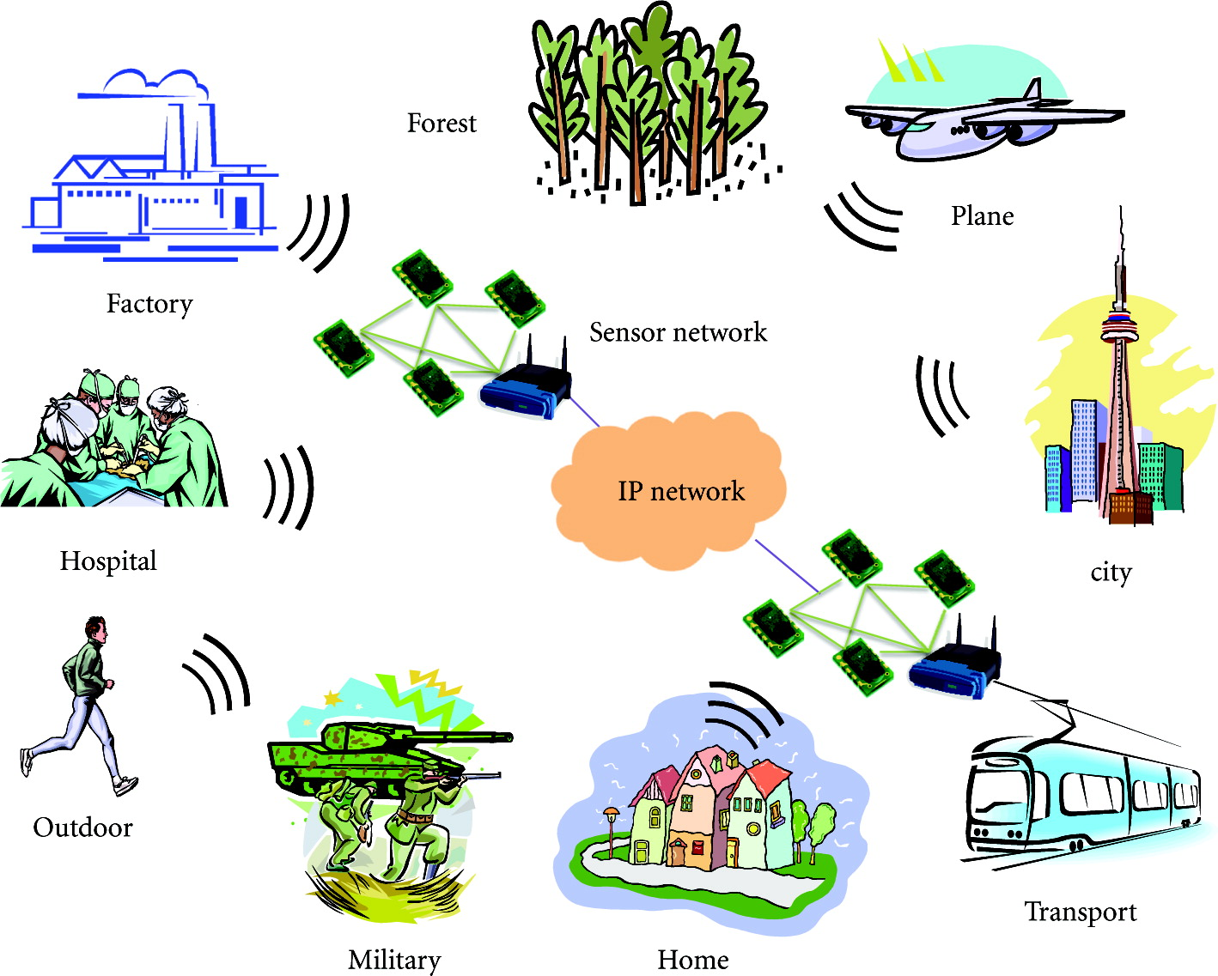
Examples of Data Collected by WSNs
Humidity and Temperature: Real-time monitoring of environmental conditions.
Location: GPS coordinates for tracking sensor positions.
Water Quality: Parameters like pH and turbidity.
Air Quality: Pollutant detection.
Animal Tracking: Wildlife behaviour monitoring.
Vibration: Structural health monitoring.

Slide 4

Basic Python
We use a Python because its versatility, making it suitable for both data analysis and machine learning.
1. Setting up an IDE
Installed Visual Studio Code and Python 3.12.4 (64-bit)
2. Pandas Library
Purpose: Data analysis and manipulation
Functions: Analyzes, cleans, explores datasets and Handles CSV files
Installation: pip3 install pandas
3. Scikit-learn Library
Purpose: Machine learning and statistical modeling
Features:
Supervised & Unsupervised learning
Clustering, Cross Validation, PCA
Installation: pip3 install -U scikit-learn

Slide 5

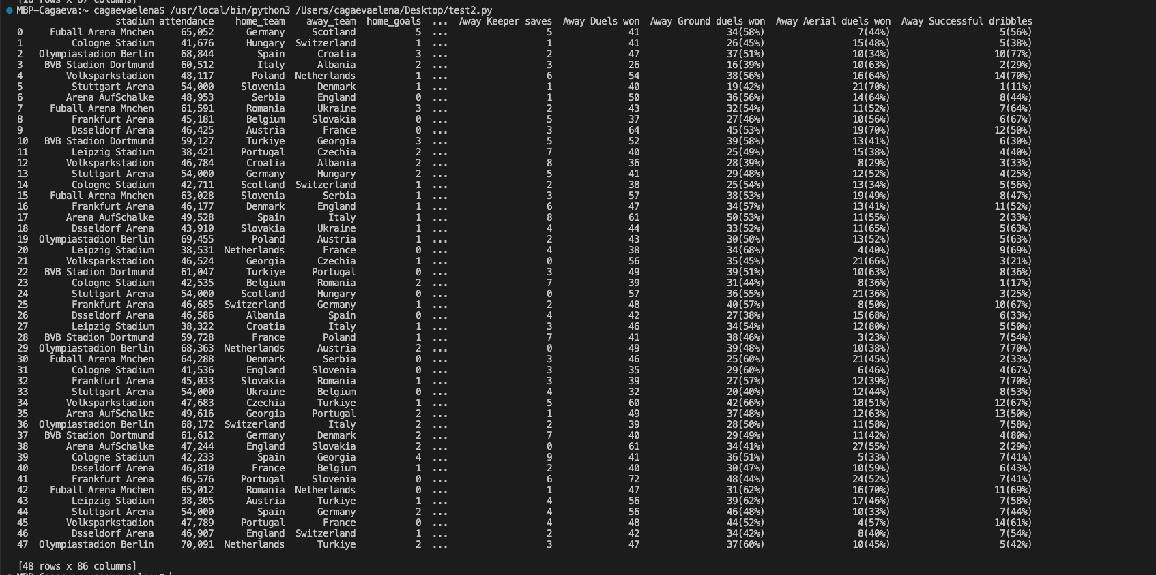
Example of code to use a CSV file for analyzing data
Input:
Output:

Slide 6
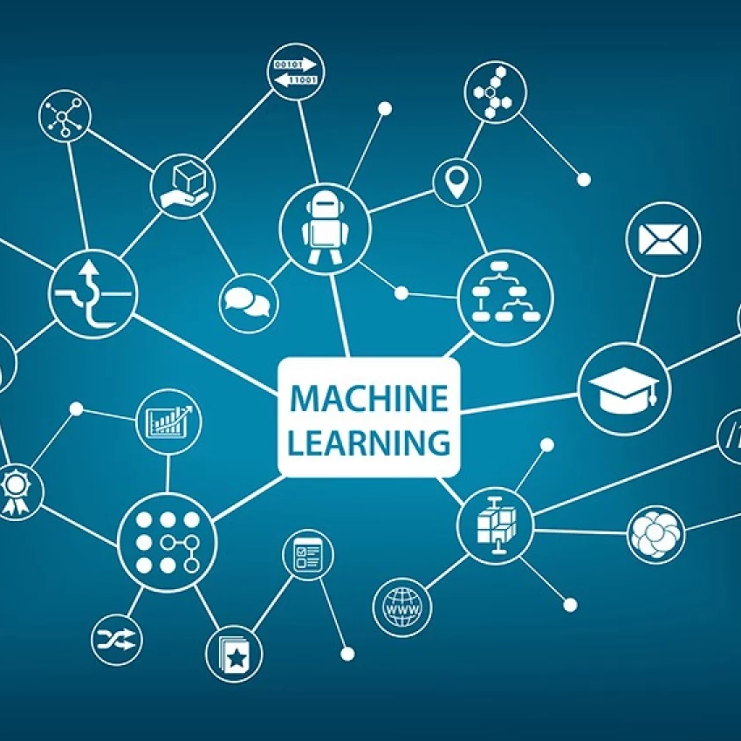
What is Machine Learning?
Machine learning (ML) is a subset of artificial intelligence (AI) where computers learn and improve on their own, similar to humans.
It involves feeding data into algorithms to identify patterns and make predictions on new data.
ML is utilized in diverse applications such as image and speech recognition, natural language processing, and recommender systems.

Slide 7
Categories of Machine Learning
Supervised Learning
Uses labelled data to train models that map inputs to outputs.
Examples: Predicting prices (regression) and classifying images (classification).
Unsupervised Learning
Uses unlabelled data to identify patterns or structures.
Examples: Customer segmentation (clustering) and reducing dimensions for visualization.
Reinforcement Learning
An agent learns to act in the world to maximize rewards through trial and error.
Example: Training a dog with rewards for correct actions.
Semi-Supervised Learning
Combines a small amount of labelled data with a large amount of unlabelled data.
Falls between supervised and unsupervised learning.

Slide 8
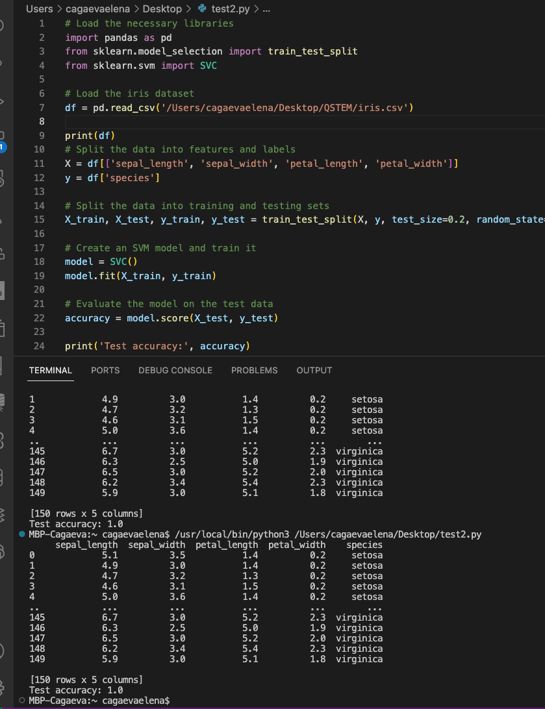
Example of code to find Accuracy
1. Import Libraries
2. Load the Dataset
3. Print the Data
4. Prepare Features and Labels:
X contains the feature columns: sepal_length, sepal_width, petal_length, and petal_width.
y contains the target column: species.
5. Split the Data:
Divide the data into training and testing sets, with 20% reserved for testing.
6. Create and Train the Model:
Initialize an SVM model and fit it on the training data.
7. Evaluate the Model:
Compute and print the accuracy of the model on the test data.

Slide 9

Classification and KNN Algorithm
A data analysis task to identify which category a new observation belongs to, based on a training set of known data.
Steps in Building a Classification Model:
Data Collection: Gather relevant data.
Data Pre-processing: Clean and format the data.
Feature Selection: Choose relevant attributes.
Model Selection: Choose an appropriate algorithm (e.g., decision trees, SVM).
Model Training: Train using the training set.
Model Evaluation: Assess performance on a test set.
Types of Classification:
Binary Classification: Two categories (e.g., “spam” vs. “not spam”).
Multi-class Classification: More than two categories.

Slide 10
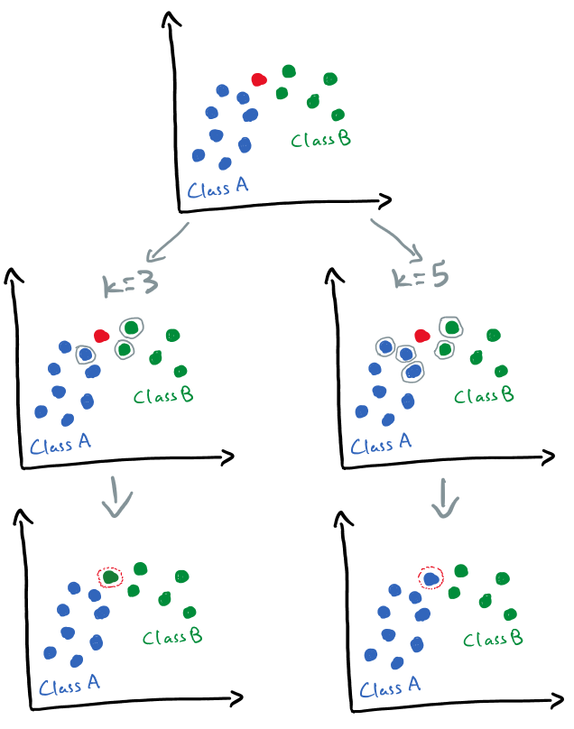
K-Nearest Neighbors (KNN) Algorithm
A supervised learning method used for classification and regression. It is non-parametric and does not assume an underlying data distribution.
How KNN Works:
Find the K nearest neighbours using a distance metric (e.g., Euclidean).
Determine the class or value by majority vote or average of the K neighbours.
Distance Metrics:
Euclidean Distance: Straight-line distance between points.
Manhattan Distance: Sum of absolute differences.
Minkowski Distance: Generalization of Euclidean and Manhattan distances.
Advantages of KNN:
Easy to Implement: Low complexity.
Adaptable: Adjusts to new data.
Few Hyperparameters: Only K and distance metric.

Slide 11
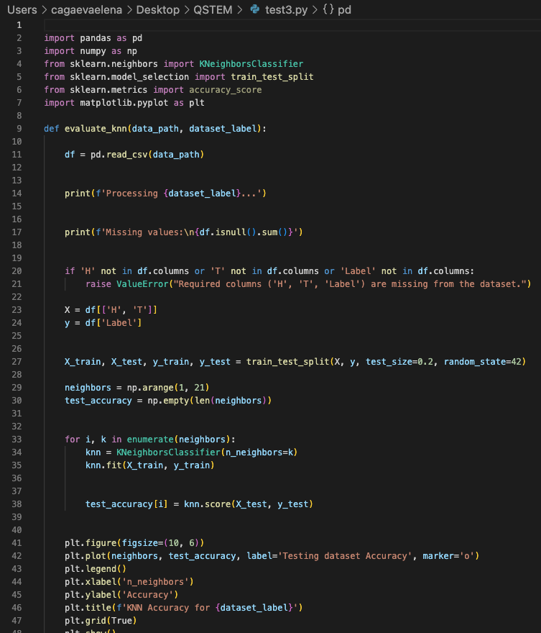
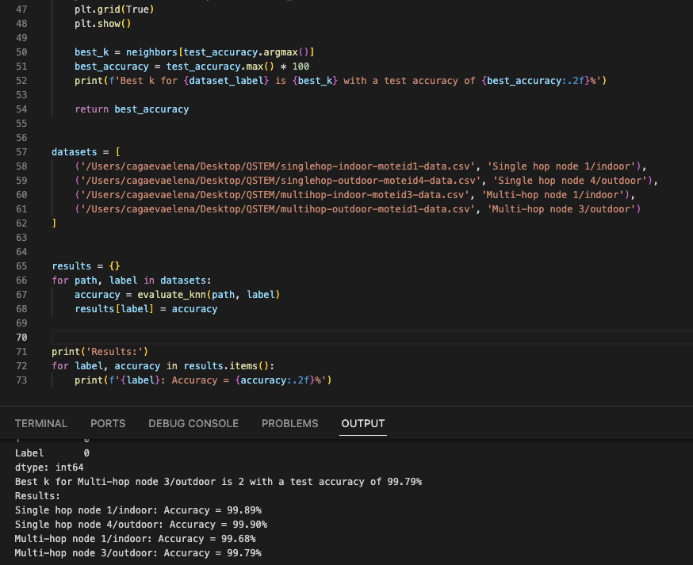
Example of how to evaluate the performance of the KNN classification algorithm on multiple datasets

Slide 12
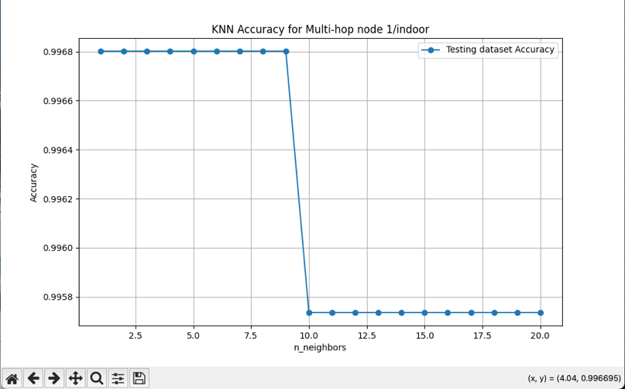
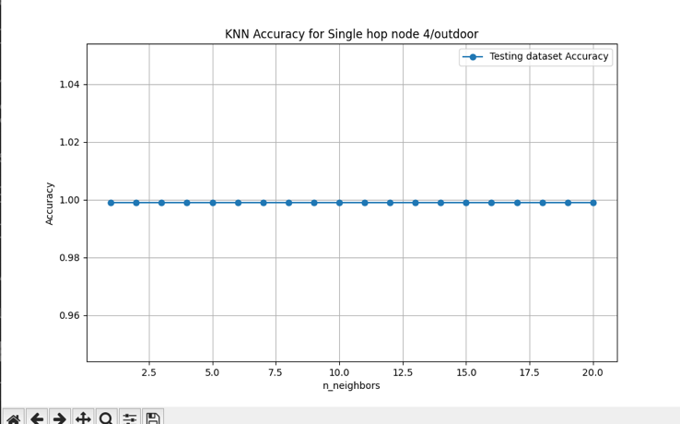
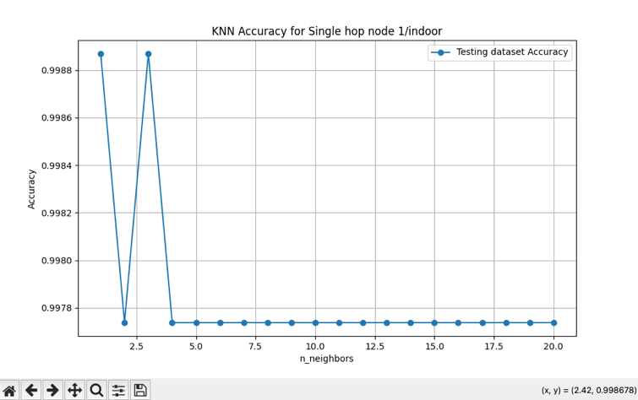
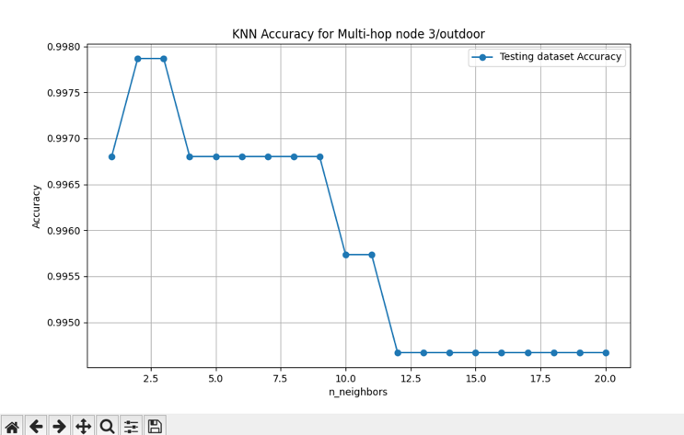
Accuracy in graphs

Slide 13

Tnank you!
QSTEM Academy Research
LaDuardia College, New York
2024

Slide 14
Resourses
https://www.youtube.com/watch?v=VchuKL44s6E
https://www.youtube.com/watch?v=ClNP-lTzKgI
https://www.w3schools.com/python/pandas/pandas_intro.asp
https://www.w3schools.com/python/pandas/pandas_csv.asp https://www.tutorialspoint.com/scikit_learn/scikit_learn_introduction.htm
https://www.geeksforgeeks.org/introduction-machine-learning/
https://www.geeksforgeeks.org/ml-machine-learning/
ML | Introduction to Data in Machine Learning - GeeksforGeeks
https://www.geeksforgeeks.org/getting-started-machine-learning/
https://www.geeksforgeeks.org/basic-concept-classification-datamining/?ref=header_search
https://www.geeksforgeeks.org/getting-started-with-classification/?ref=header_search
https://www.geeksforgeeks.org/k-nearest-neighbours/?ref=header_search
https://www.geeksforgeeks.org/k-nearest-neighbor-algorithm-in-python/

